Slide 1
Flip Robo Corporation Welcome To The Costumer Retention Project
Submitted by honey chaudhary
Submitted to sir shubham yadav

Slide 2
Content
Here we perform eda process mainly so we made many graph like,
Scatter plot for bivariate analysis
Box plot and distplot for univariate analysis
Histogram
Swarmplot
Violin plot
Like this we do analysis this dataset properly

Slide 3
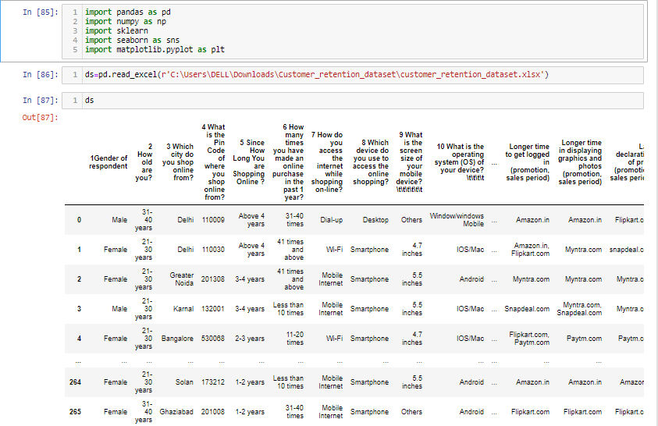
IMPORT THE DATASET

Slide 4
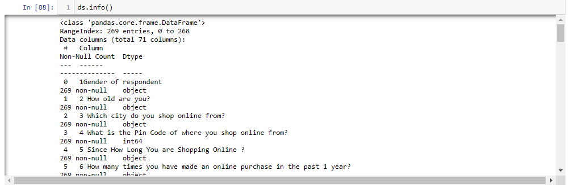
Imformation about the dataset

Slide 5
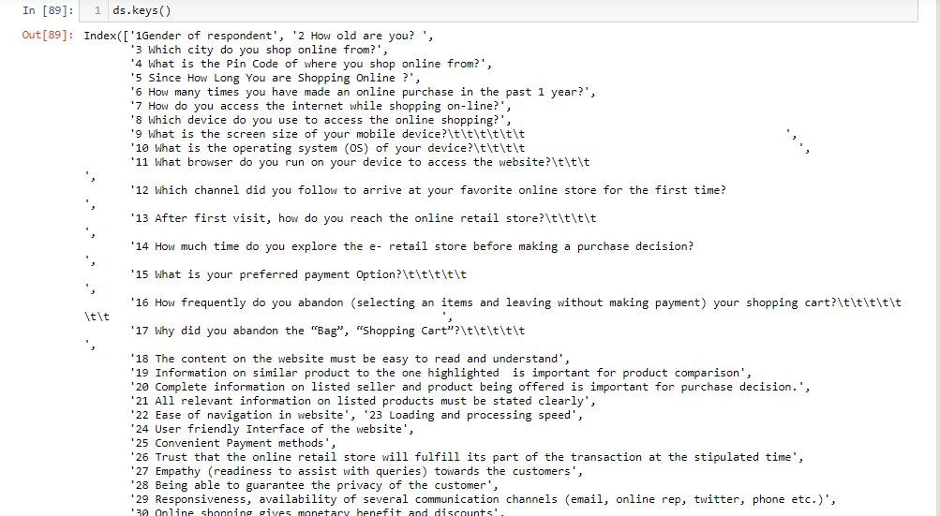
Keys of the dataset

Slide 6
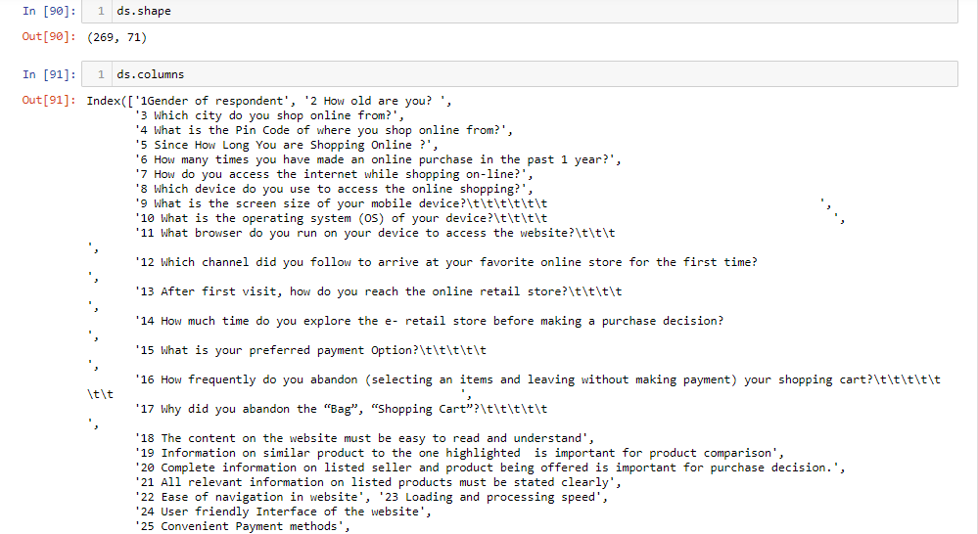
Shapes and columns of the dataset

Slide 7
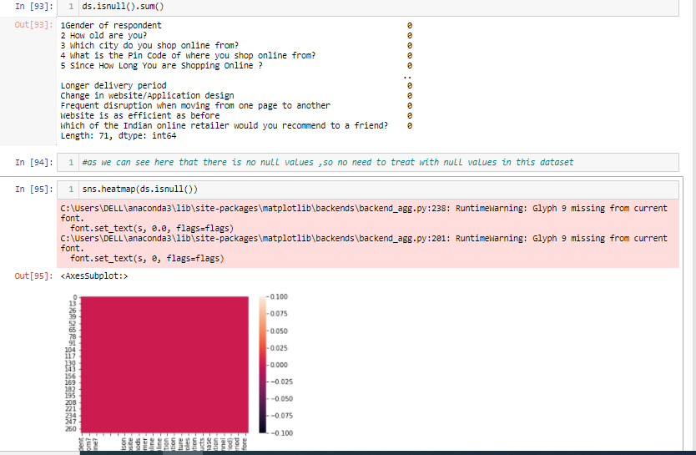
Treating with null values and check on heatmap

Slide 8
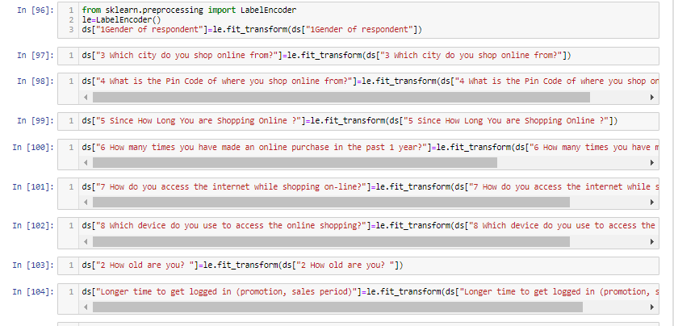
Converting Object Table To Integer

Slide 9
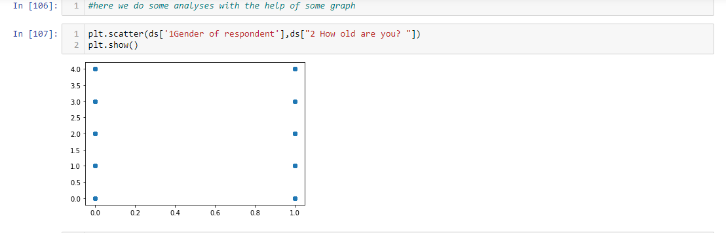
Scatter plot

Slide 10
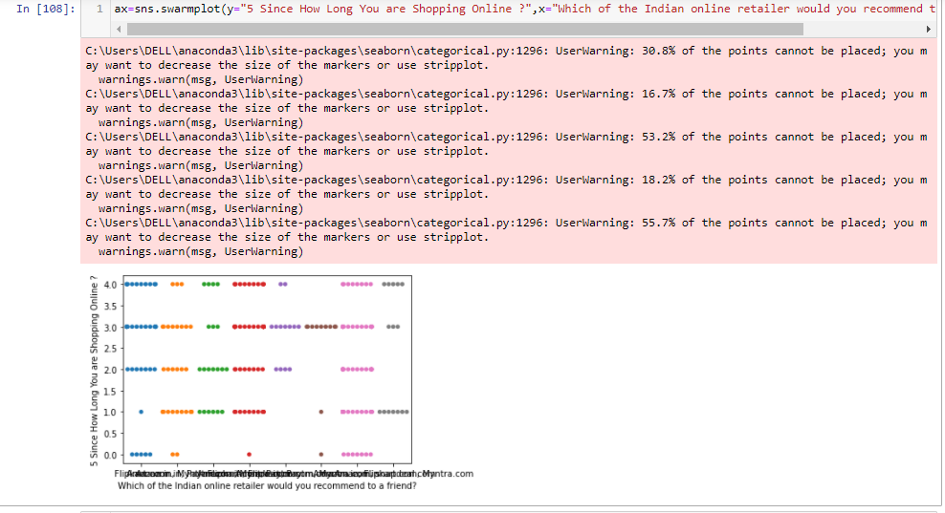
Swarm plot

Slide 11
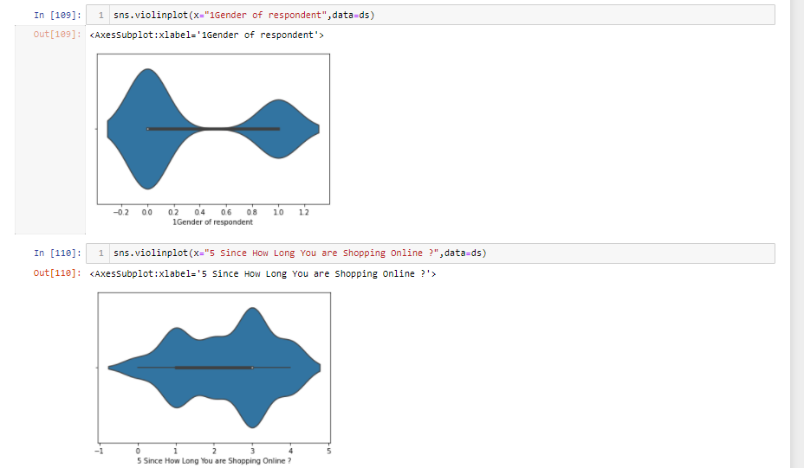
Violin plot

Slide 12
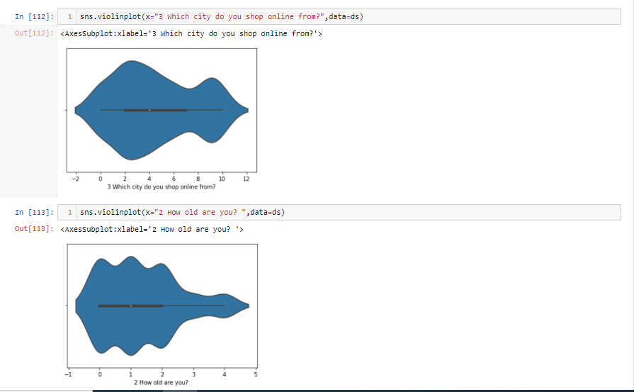
violin plot

Slide 13
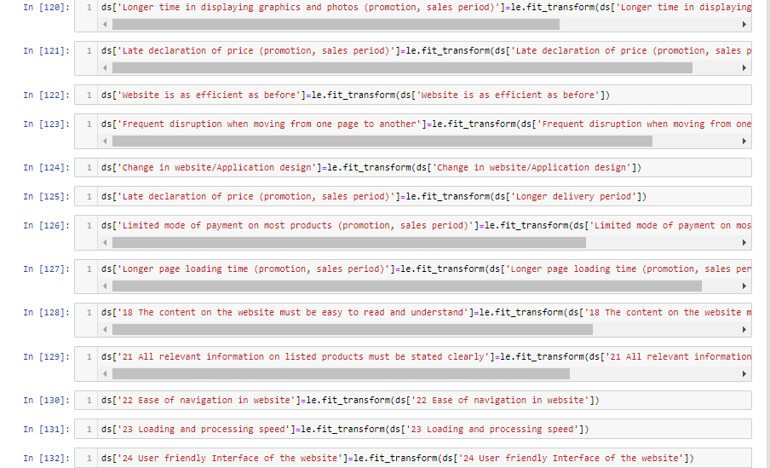
Converting some more table into integer by power transform

Slide 14
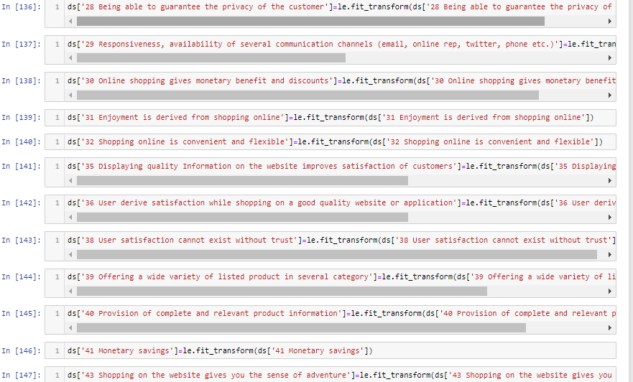
Some more table into integer

Slide 15
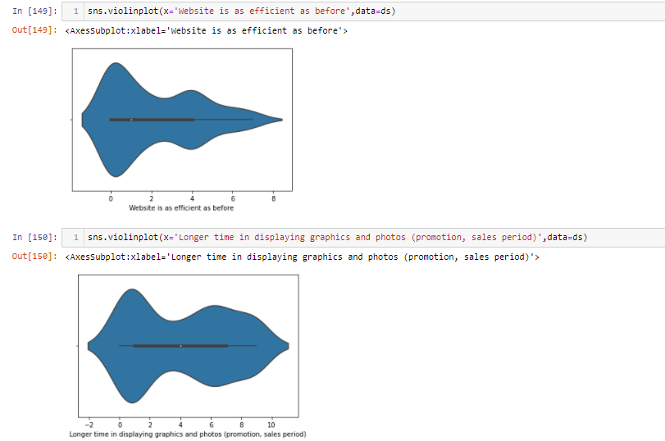
Violin plot

Slide 16
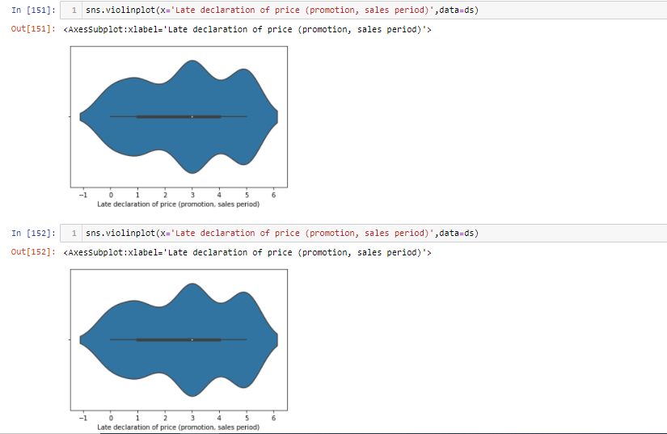
Violin plot

Slide 17
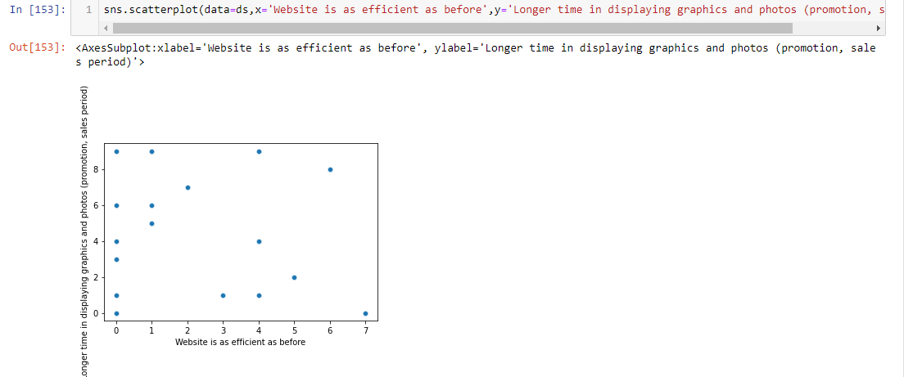
Scatter plot

Slide 18
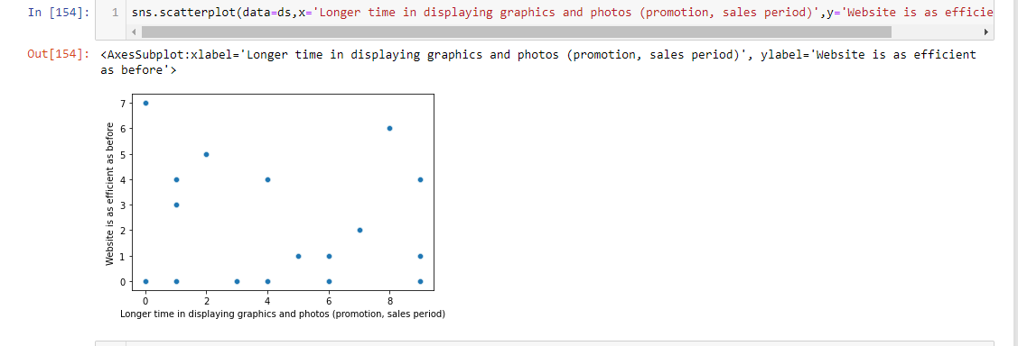
Scatter plot

Slide 19
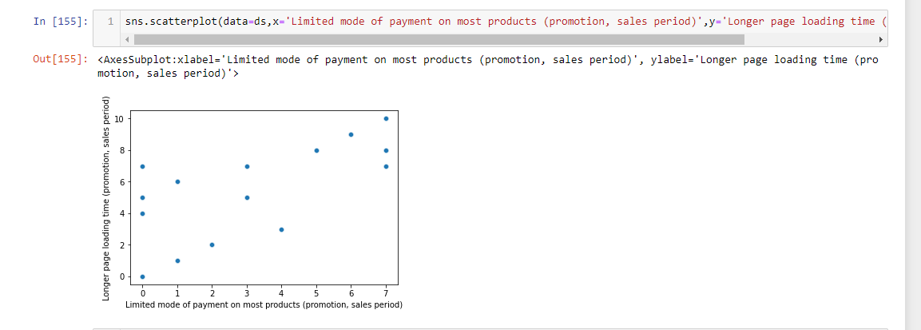
Scatter plot

Slide 20
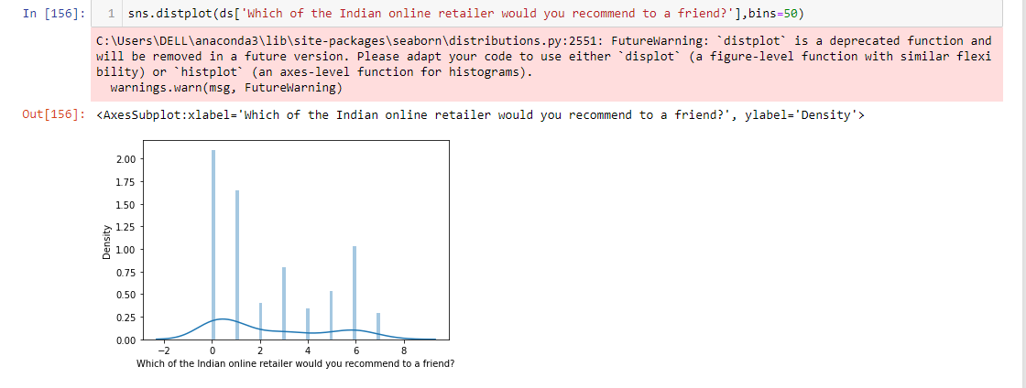
Distplot

Slide 21
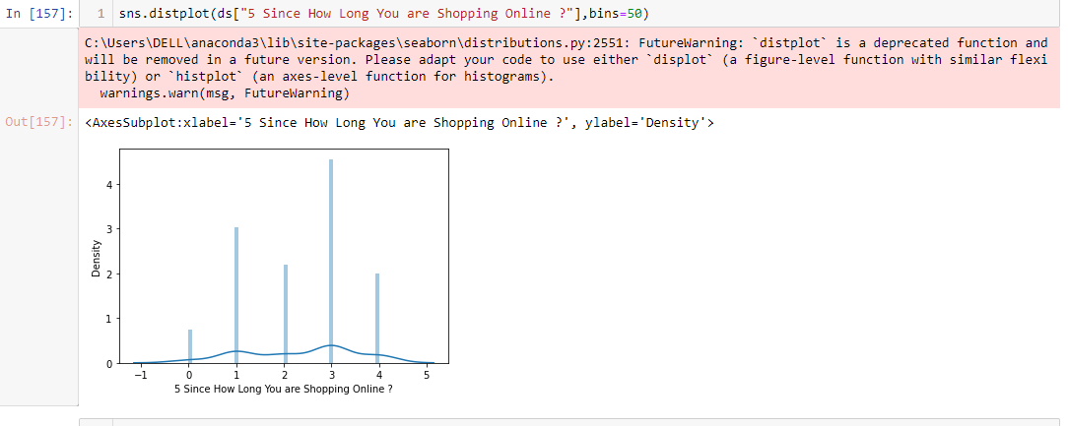
Distplot

Slide 22
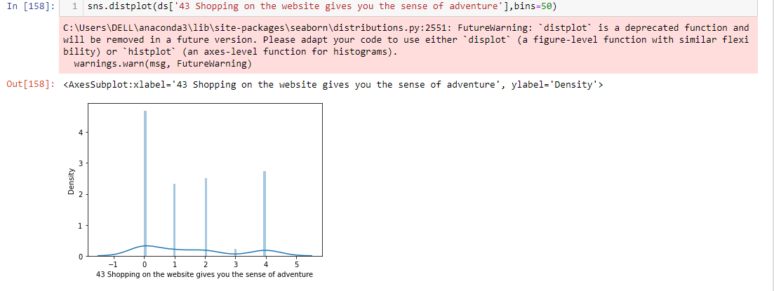
Distplot

Slide 23
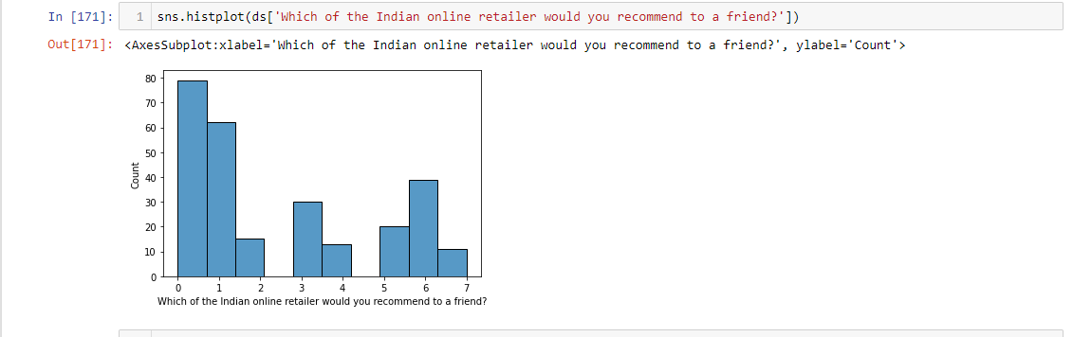
Histogram

Slide 24
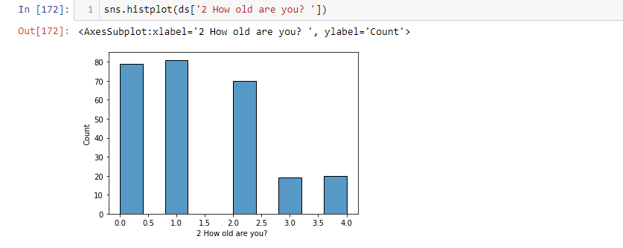
Histogram

Slide 25
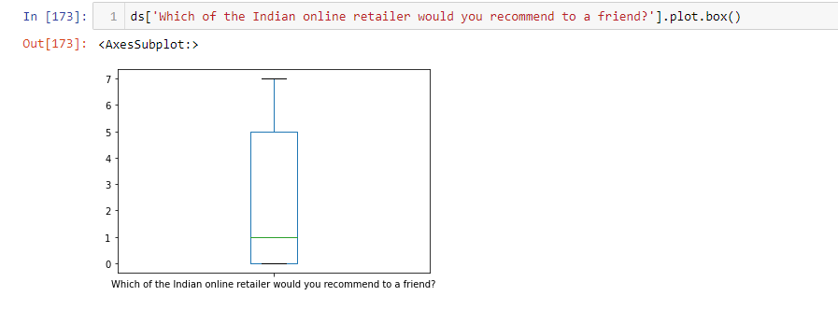
Boxplot

Slide 26
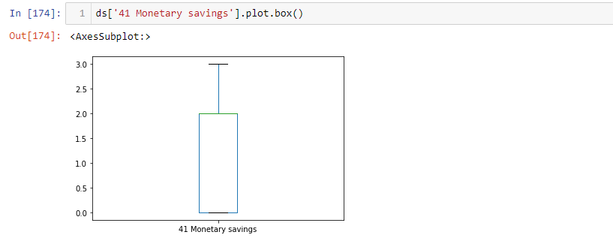
Boxplot

Slide 27
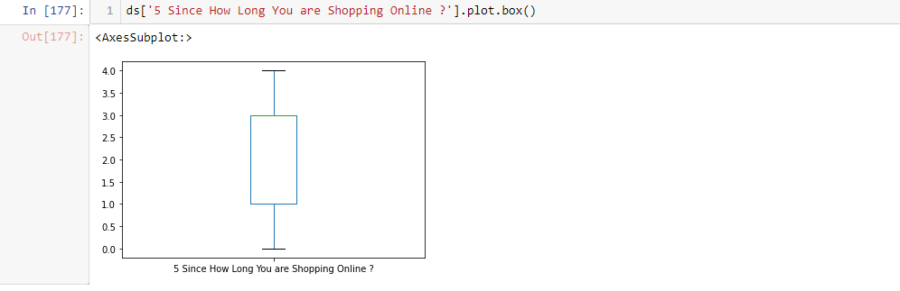
Boxplot

Slide 28
Thanks
For
Watching

